Slide 1


Slide 2
Attack & Defence
VPN is required in order to connect into Attack & Defence environment. Please install OpenVPN.
The duration is 6 hours and each tick is 5 minutes.
Tick?
One tick is one round in attack & defence.
Flag changes every tick and older flags will be invalid to submit

Slide 3
Attack & Defence
Tick?
One tick is one round in attack & defence.
Flag changes every tick and older flags will be invalid to submit.
Rule: The validity of flags is 5 ticks. The latest 5 ticks of flag will be valid and the rest will not be.

Slide 4
Attack & Defence
Example:
Tick 1: BOH25_sdyhfksadfshdfsdf (INVALID)
Tick 2: BOH25_sadlfujdsalkjfbndsf (VALID)
Tick 3: BOH25_cmxkmopqweirun (VALID)
Tick 4: BOH25_weoruihewnmcxn (VALID)
Tick 5: BOH25_asdlfuihlweifnfnm (VALID)
Tick 6: BOH25_kwsqeugfkwejbdnf (VALID)

Slide 5
Attack & Defence
Team 1 Machine
Machine is used to:
Gain access to challenges
Submit flags
Patch challenges
Attack other teams

Slide 6
Attack & Defence
Team 1 Machine
White box challenges can be patched before being pwned
Black box challenges cannot be patched until it is pwned

Slide 7
Attack & Defence
Team 1 Machine
White box challenges are in:
/home/player/challenge1/
/home/player/challenge2/
Black box challenges are in:
/home/challenge1/
/home/challenge2/
Flags are in:
/home/user/flag.txt

Slide 8
Attack & Defence
Team 1 Machine
Example challenge directory:
app.py (Patchable)
Dockerfile (Unpatchable)
docker-compose.yml (Unpatchable)
restart_docker.sh cooldown of 10 minutes

Slide 9
Attack & Defence
Team 1 Machine
When patching, please keep in mind that you have to keep your challenges up and running.
Bringing your challenge down will cause your team to be penalized.
The goal of patching is to defend yourself (Defence Points) and also keeping your services alive (SLA Points)

Slide 10
Attack & Defence
Team 1 Machine
Flag Submission:
nc gameserver 6666
Only flags submitted through your team’s machine will count towards your score.

Slide 11
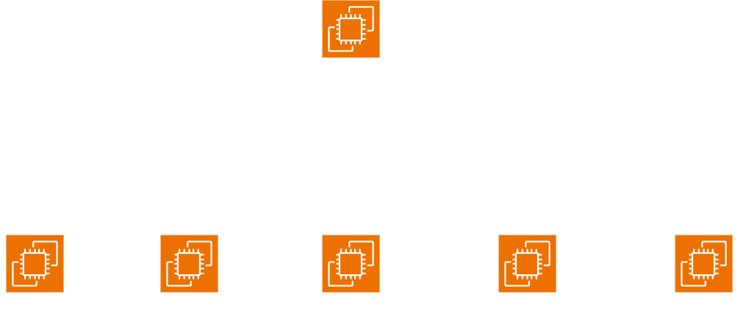
Attack & Defence

Slide 12
Attack & Defence
Tick 1
Team 1 Machine: BOH25_sdyhfksadfshdfsdf
Team 4 Machine: BOH25_qeworiueqhoncdifd
Team 2 Machine: BOH25_dfwertggdsadfdsf
Team 5 Machine: BOH25_qweiouwhnmioedf
Team 3 Machine: BOH25_opkoindbiuwqicdf

Slide 13
Attack & Defence
Tick 2
Team 1 Machine: BOH25_flagflagflagflag
Team 4 Machine: BOH25_huehuehuehuehue
Team 2 Machine: BOH25_fakefakefake
Team 5 Machine: BOH25_hahaahahahahah
Team 3 Machine: BOH25_heeheeheeheehee

Slide 14
Attack & Defence
Tick 3
Team 1 Machine: BOH25_fsecss_boh25
Team 4 Machine: BOH25_pls_dont_use_these
Team 2 Machine: BOH25_hohohohohoho
Team 5 Machine: BOH25_aslkdfhjbsadbsdkjf
Team 3 Machine: BOH25_these_r_fake

Slide 15
Attack & Defence
Scoring System
SLA Points (Keeping ur challenges alive)
Attack Points (Attacking other teams)
Defence Points (Preventing your flag from being submitted)
SLA Points (Given Dynamically)
Attack Points (2 if you submit correct flag)
Defence Points (-1 if other team submit your flag)

Slide 16
Attack & Defence
Software/Hardware Needed
OpenVPN Software
Extensions (If you have)
Mobile Data (If you have, venue might block the use of VPN)

